Slide 1


POP Mortgage Bank
Cover Pool Report
Q2/2026

Slide 2

POP Bank Group and POP Mortgage Bank Plc
The POP Bank Group consists of the member cooperative banks (POP Banks) of the POPC (POP Bank Centre coop), the POPC and organizations under their control. POPC, the central institution, is responsible for the group steering and supervision in accordance with the Act on the Amalgamation of Deposit Banks
POPMB (POP Mortgage Bank Plc) acts as the mortgage bank and a member cooperative bank of the POP Bank Group
The POP Bank Centre coop has a 100% ownership of POPMB. POPMB falls within the joint liability of the POP Bank Group
POP Mortgage Bank Plc is committed to continuously maintain an overcollateralization at a level commensurate with the S&P rating level of ‘AAA’
The minimum overcollateralization required by law is 2% (Covered Bond Act)
POP Mortgage Bank rating report can be found on the banks’ website https://www.poppankki.fi/en/investors/information-for-investors/investor-relations/credit-rating
The POP Bank Group
The amalgamation of POP Banks
JOINT LIABILITY
Companies included in the
consolidated groups
MEMBER COOPERATIVE BANKS
Member credit institutions
POP BANK CENTRE COOP
Central institution
100%
100%
BONUM BANK PLC
Central credit institution
Member credit institutions
POP MORTGAGE BANK PLC
Mortgage bank
Member credit institutions
100%
POP HOLDING LTD

Slide 3
Cover pool characteristics
Key characteristics of the cover pool
Size of the pool | EUR 671.7 million (nominal)
Collateral type | 100% Finnish residential mortgages
Number of loans | 12,268
Average loan size | EUR 54,752
WALTV | 65.9%
WA loan seasoning | 74.3 months
Non-performing loans | 0.0 %
Loans in arrears (> 30 days past due) | 0.0 %
Interest rate base | 93% floating / 7% fixed
Over-collateralisation | 34.34%
Customers | 100% retail customers
Currency | Only EUR
Max loan size | EUR 3.0 million
Max maturity | 30 years
Customer rating | AAA-A
Max LTV | 100% (of which 70% is accounted for in the pool)
Interest rate | Euribor, POP Prime, Fixed
Outstanding issues
ISIN | Issue Date | Maturity Date | Nominal | Coupon
FI4000550371 | 26.4.2023 | 26.4.2028 | 250 000 000 | 3.625 %
FI4000581715 | 15.10.2024 | 15.10.2029 | 250 000 000 | 2,875 %
3

Slide 4
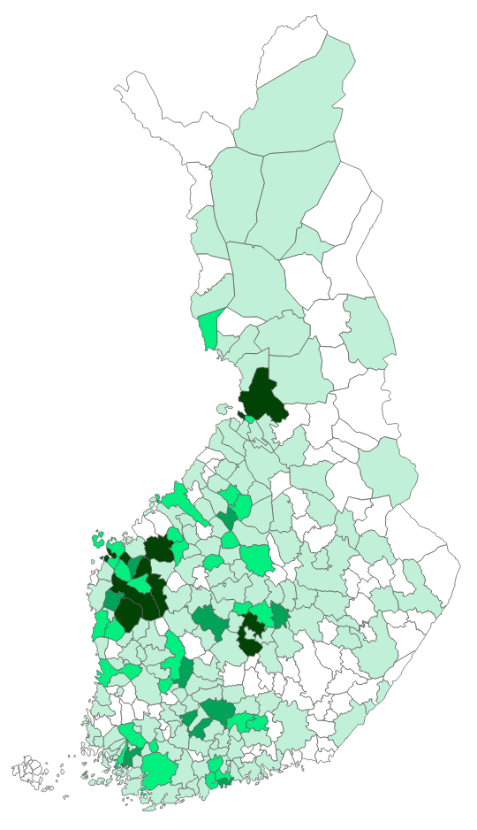
Geographical distribution

Slide 5
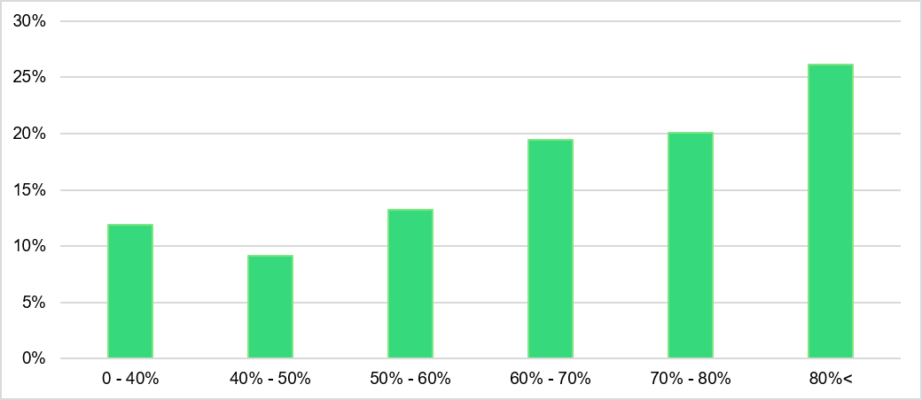
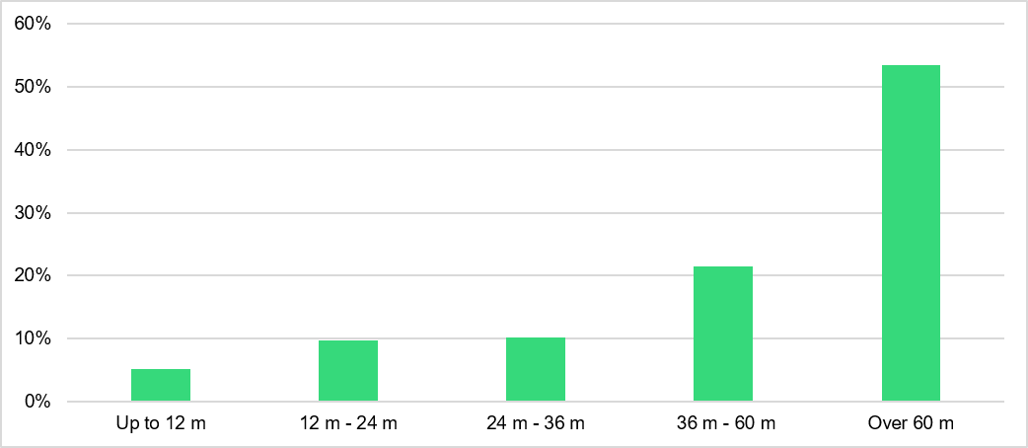
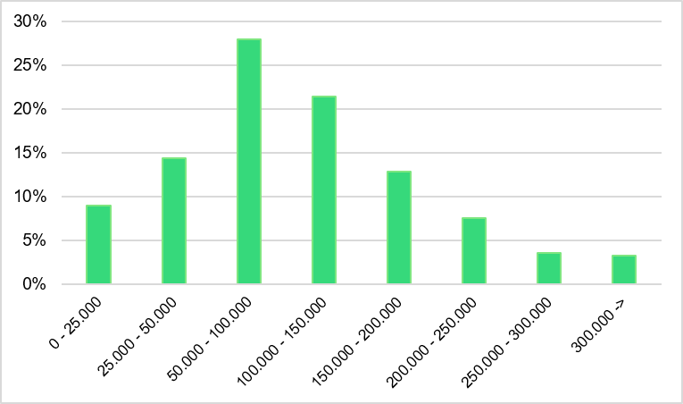
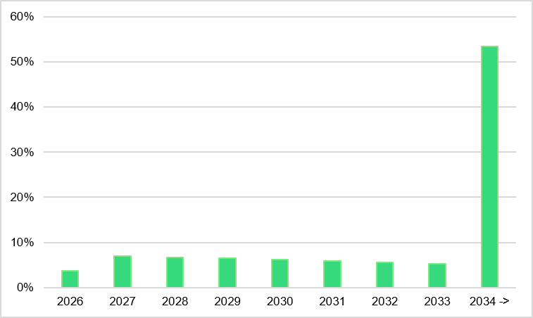
Cover pool data
LTV distribution of the pool
Loan seasoning of the pool
Loan size buckets (EUR)
Cover pool maturity profile
5

Slide 6
Risks related to covered bonds I
Interest rate risk
  In general, as market interest rates rise, covered bonds bearing interest at a fixed rate generally decline in value. Consequently, investment in fixed rate Covered Bonds involves the risk that subsequent changes in market interest rates may adversely affect the value of the fixed rate Covered Bonds since fixed rate Covered Bonds have a fixed rate of interest and prevailing interest rates in the future may be higher than that fixed rate of interest.
  A holder of floating rate Covered Bonds is exposed to the risk of fluctuating interest rate levels and uncertain interest income. Fluctuating interest rate levels make it impossible to determine the yield of floating rate Covered Bonds in advance. In the event that the reference rate used to calculate the applicable interest rate turns negative, the interest rate on the Covered Bonds will therefore be below the margin as specified in the Final Terms and may be zero. Accordingly, the holders of floating rate Covered Bonds may not be entitled to interest payments for certain or all interest periods. Neither the current nor the historical value of the relevant floating rate should be taken as an indication of the future development of such floating rate during the term of any Covered Bond.
Foreign exchange rate risk
  POP Mortgage Bank operates only in euros.

Slide 7
Risks related to covered bonds II
Credit risk
  Holders of the Covered Bonds take a credit risk on the performance of the Issuer, the Group and the Amalgamation to the extent that claims of the holders of Covered Bonds in respect of the Covered Bonds are not met out of the Cover Asset Pool. Receipt of payments under the Covered Bonds by a holder of Covered Bonds is dependent on the Issuer’s ability to fulfil its payment obligations, which is in turn dependent upon the development of the Group’s and Amalgamation’s business. Notwithstanding the joint liability under the Amalgamation Act between the Issuer and the POP Banks, there is no guarantee in place which directly ensures the repayment of Covered Bonds. The payment obligations under the Covered Bonds are covered obligations of the Issuer and are not obligations of, and are not guaranteed by, the POP Bank Centre nor any POP Bank.
Valuation methods
  A Mortgage Loan entered in the Register as collateral for a covered note may not exceed the current value of the shares, housing property or commercial real estate standing as collateral. The current value shall be calculated using good property evaluation practice applicable to credit institutions in accordance with provisions on the management of capital adequacy and credit risk of credit institutions issued by the FIN-FSA. The issuer shall regularly monitor the value of the shares, housing property or commercial real estate entered as collateral for the covered notes and revise the value of the collateral in accordance with provisions on the management of capital adequacy of credit institutions issued by the FIN-FSA.
Liquidity risk
  Short-term liquidity risk refers to a quantitative and temporary imbalance of the Issuer’s or any Group member’s short-term cash flow. If realized, the risk means that the Issuer or other member of the Group will not be able to meet its payment obligations at the time they are falling due. Liquidity risk, if realized, may jeopardize or prevent continuation of the Issuer’s business operations and thereby its ability to fulfil its obligations under the Covered Bonds.

Slide 8
Maturity extension
Enablement of maturity extension
  Pursuant to Section 32 of the Covered Bond Act, the terms and conditions of a covered note may include a provision that enables the issuer to extend the maturity of a covered note subject to certain conditions, including the approval of the FIN-FSA. In addition, the conditions for extension of maturity include, among others, that the issuer is unable to obtain long-term financing from ordinary sources, the issuer is unable to meet the liquidity requirement set out in the Covered Bond Act if it makes payments towards the principal and interest of the maturing covered note and that the extension of maturity does not affect the sequence in which the issuer’s covered notes from the same Cover Asset Pool are maturing. If the FIN-FSA determines that the conditions for extension have been fulfilled and it gives its approval to the extension, its resolution shall indicate the applied extended maturity date of such covered notes which shall be a date on or before the final extended maturity date specified in the General Terms and Conditions.
Implications of maturity extension
  If “Extended Final Maturity” if specified as being applicable in respect of a Series of Covered Bonds, the maturity date of the relevant Covered Bonds may be extended subject to certain conditions, including approval of the FIN-FSA. In the event of such extension, the Issuer may redeem all or any part of the nominal amount outstanding of the Covered Bonds on an Interest Payment Date falling in any month after the Maturity Date up to and including the Extended Final Maturity Date. The extension of the maturity of the outstanding principal amount of the Covered Bonds to a date falling after the Maturity Date will not result in any right of the holders of Covered Bonds to accelerate payments on such Covered Bonds and no payment will be payable to the holders of Covered Bonds in that event other than as set out in the General Terms and Conditions.

Slide 9
Contact information
Timo Hulkko, CEO, POP Mortgage Bank Plc
Email: timo.hulkko@poppankki.fi
Tel: + 358 500 894 008

